Slide 1
LV618 4G_5G migration internal kick-off Jun 10, 2025

Slide 2
Project Context and Background – Customer & Nokia
Goals
Project Goals – Benefit KDDI's business and operational objectives through the 4G/5G SDM Migration - Ph2 LV618 project. The final goal is 4G/5G migration by LV623.
Critical Success Factors – successful migration, deployment of 5G SDM network functions without service interruption.
Pressing milestones –
- LV618A Target Acceptance Dates: End of October 2025 and End of April 2026.
- LV618B Target Acceptance Dates: End of October 2025 and End of April 2026.
Nokia
Overall TCO : 1 years of implementation + 1 year of Care
Any LDs/Penalties triggers: Yes
Other Key Partners
Customer Partners – Dell for HW, RedHat for OCP
Nokia Partners – Infinite, Wipro
MS Partner – N/A
Other BGs involved – N/A

Slide 3
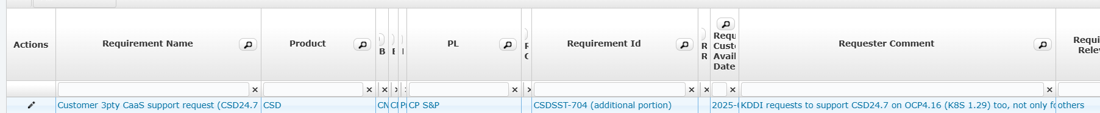
Scope – HW, SW & Services – Nokia and any 3rd Party
HW
Products – N/A
Vendor & BOQ – N/A
Standard / PSI – N/A
Forecast status & Lead time – N/A
Software
CNS
Products & Versions – Later slide
Compatibility Matrix – Later slide
Pre-C3s: Deal breakers – Committed.
S/W & Licenses BOQ - LV618AB_KDDI_24.JP.375003.01_NPT 75.0.0_5G-SDM_Migration_4G-SDM_re-installation_5G-SDM_PCF_system_installation.xlsb

Slide 4
1. Project Overview

Slide 5
1. Project Overview
Requirements Building the following nodes on the KDDI Common Virtualization Infrastructure (KYANOS)
Overall HLD LV553-C
AUSF/UDM LV618A
SCPv/BSF/DRA LV618A
PCFv/PCRFv LV618A
Mirroing Server LV618A
4G/5G Integrated EIR LV618A
4G/5G Integrated HSS/HLR LV618B
Project name
PO#102001124500 - LV 553 -C _ 5 GCSA _ Next Expansion and SDM Migration on KYANOS (Build) PO#102001302455 - LV618A_5GCSA_5G-SDM Integrated Migration on KYANOS PO#102001298117 - LV618B_5G-SDM Migration _ Integrated HSS Build
Completion Date April 2026

Slide 6
2.Project Scope

Slide 7
Excerpt from our company Pre-Sales Proposal
2. Project Scope
 | Work description | Comments​ |  | NOKIA | Dear KDDI Dear xGN
1) 5G-SDM Construction
 | 5G-SDM Construction | 4G/5G EIR (rebuild), HSS/HLR (rebuild), AUSF/UDM, SCP/BSF/DRA (SCPv), PCF/PCRFv, Mirroring Server V, NCOMv (new) | 4G/5G EIR (rebuild), HSS/HLR (rebuild), AUSF/UDM, SCP/BSF/DRA (SCPv), PCF/PCRFv, Mirroring Server V, NCOMv (new) | R | S
2) Integration with existing
 | NZEv, Custom Server v | NZEv and Custom Server V are the only existing integrations. (The new integration is in the Scope, while the other existing integrations are in the LV623 Scope.) |  | R | S
Proposal Nok5Gsa-SL-5386-4 N_LV618AB_ Integrated SDM_5G-SDM Migration Proposal _20250319.pdf

Slide 8
Excerpt from our company Pre-Sales Proposal
2. Project Scope
Scope range
System expansion, migration, and upgrade in three phases
Phase0
4G-PCRF migration
vIMS accomodation
Phase1
Integrated system construction
4G-SDM migration
MGMT system migration (partial)
System upgrade on HaaS (SDL, AUSF/UDM, HSS/HLR, PCF/PCRFv, SCP/BSF/DRA)
Phase2
Infrastructure resource expansion
Integrated system addition
5 GC migration
MGMT system migration (partial)
Phase3
4G/5G PCRF integration
Next slide shows scope by contract (LV number)

Slide 9
Excerpt from our company Pre-Sales Proposal
2. Project Scope
Legend:
5G side ordered
4G side ordered
5G side not ordered
4G side not ordered
CR for integration
Work for KDDI/xGN
Support for NOKIA
Version 2025/4/21
 | 2024 |  |  |  |  | 2025 |  |  |  |  |  |  |  |  |  |  |  | 2026 |  |  |  |  |  |  |  |  |  |  |  | 2027
 | 08 | 09 | 10 | 11 | 12 | 01 | 02 | 03 | 04 | 05 | 06 | 07 | 08 | 09 | 10 | 11 | 12 | 01 | 02 | 03 | 04 | 05 | 06 | 07 | 08 | 09 | 10 | 11 | 12 | 01 | 02 | 03 | 04 | 05 | 06 | 07 | 08 | 09 | 10 | 11 | 12
Existing 5GC HaaS side
4-6-1
HaaS SDL ExP Upgrade (24.7)
5-3
5-4
LV603A/B
5-2-1
5G-SOGW Upgrade in Provisioning Migration
LV604
Not PO
NF Removal
NAC/NetAct Removal
5G-SOGW eps area deleted/SDP upper limit value changed
5-4
OAM migration
4-6-2
Integration SDL ExP Upgrade (24.7)
4G SO GW EIR IMEI Prefix Double Probi
/ Model information transfer stop (V/K-LAB verification/commercial application)
5-2-2
4G-SOGW Upgrade in Provisioning Migration
5G-SDM Migration to KYANOS
Migration
5-2-3
Voice Migration
5-2-4
Proxy Connection (SDL-SDL) + DB Migration (*)
5-2-5
Diameter Migration
Applicable NF/NE/System (Ph.2):
AUSF/UDM, 5GEIR/EIR (reconstruction), HSS/HLR (reconstruction), SCP/BSF/DRA, PCF/PCRFv, Mirroring Serv. V
5-2-6
MAP Migration
5-2-7
SBI Migration
LV623-A/B
PO Received April 30, 2025
5-2-1
Provisioning Remaining Migration Preparation
Note)NF/NE/System: 4G/5G common / NF/System: 5G only/NE: 4G only (winding)
[5GC-SDM→ Integrated SDM Migration]
Signaling path changed at peer node(SBI, Diameter) for 5GC
4-6-3
LV618A/B
V Lab build/test
KDDI Lab build/test
LV607
Not PO
Commercial system build
LV553-C
4-6-5
5-5
5-6
Overall design HLD
Construction of maintenance environment
LV633
August 2025 PO desired
PCRFv TEG
Signaling path changed at peer node (Diameter) for 4G/5GC
Removal of NF
3-3
*Proxy connection (Voice Migration Step3/Dia Migration Step3/MAP Migration Step3/SBI Migration Step6) and DB migration (Voice Migration Step6/Dia Migration Step9/MAP Migration Step8/SBI Migration Step9) are included.
Project scope and node breakdown
Build on KYANOS (breakdown)
AUSF/UDM New build
SCPv/BSF/DRA New build
PCFv/PCRFv New build
Mirroing Server New build
4G/5G integrated EIR rebuild
4-6-4
4G/5G integrated HSS/HLR rebuild

Slide 10
3. Solution Overview

Slide 11






































Excerpt from our company Pre-Sales Proposal
3. Overview
- Target Node
Scope Range
■5GC Existing system built on HaaS
■NCC/NPC System built on KYANOS
■4G/5G integration System built on KYANOS
■4G SDM System built on KYANOS
■4G SDM existing system
Fulfillment
LCM/Orch.
EDR log
Log, H/C
Assurance
EMS
B&R
SO/Prov.
DB Search
DB Search
EDR log
Log, H/C
EMS, B&R
EDR log
EMS
SO/Prov.
DB Search
EDR log
Log, H/C
Assurance
EMS, B&R
Existing
FO
NCOM
NWR
Cust. Serv.
NAC
NetAct
ARC
5G-SOGW
Search Serv.
NWRd
Cust. Serv.D
NAC
NZEd
Search Serv.
NWRv
Cust. Serv.V
NZEv
Log Server
NetAct
SOGW
Search Serv.
Build Nodes and Connections
CHFoff/Mediator/BSS-GW
5GSA subscriber accommodation
CHFoff/Mediator
LCM/Orch.
LCM/Orch.
Mediator
LCM/Orch.
4G/NSA subscriber accommodation
NM
ExP UPG
UDR
NMd
NCOMd
NCOMv
ExP UPG
UDR
4G/NSA subscriber accommodation
NMv
NCOMv
UDR
SDL
SDL
One-NDS
CHFon OCS
PCFd PCRFd
PCFv PCRFv
UDM AUSF
HSS HLR
5G-EIR
EIR
OCS CHFon
PCFd PCRFd
PCFv PCRFv
UDM AUSF
vHSS vHLR
5G-EIR EIR
vPCRF
PCRFv
HSS HLR
EIR
NCC
NPC
NPC
Registers AUSF/UDM
Registers HSS/HLR
One-EIR
One-EIR
NCC
NPC
NPC
Registers AUSF/UDM
Registers HSS/HLR
One-EIR
NPCs
PCS5000
Registers HSS/HLR
One-EIR
(Re) Build Only
DRA
STP
U-DRA
CNDRA
BSF
SCP
ELK Search
DRAd
SCPd
ELK Search
cHDR
CNDRA
BSF
SCPv
ELK Search
vPDR
PDR
HDR
CSD
telesys MACHi7
CSD
CSD
Mirroring Serv.
CSD
CSD
Mirroring Serv. D
CSD
CSD
Mirroring Serv. V
CSDs
CMS8200
CMS8200
Route switching
Route switching
Route switching
Route switching
Route switching
GW-STP
IMS
P-CSCF
AS
AMF MME
SMF SPGW
SCC-AS
DEA
SCC-AS
DEA
NTAS
CSD
NTAS
CSD
Ph.2 Restructuring Integrated facilities
Ph. 2 installed Integrated facilities
http/2
NOKIA installation system
Diameter
New Build
Existing NF/NE
NOKIA product (CNF)
MAP
NOKIA product (VNF/VM)
Others
NOKIA product (BM)

Slide 12
3N Updated
3. Solution Overview
- Integration Matrix
Product name | OCP version | SW version | Signaling Opposing device | Installer device | Construction method | MGMT Opposing device (existing)
 |  |  |  |  |  | FM/PM | CM | B&R | Log collection | Health Check
AUSF/UDM | 4.18 | 24.7 | Connection up to Lv618 build unit | NCOMv | New | NZEv | GUI/CLI | NZEv | CSv | CSv
HSS/HLR | 4.18 | 24.7 |  |  | Sengu
One-EIR(4G/5G) | 4.18 | 24.7 |  |  | Sengu (4G) New (5G) |  | CLI
SCPv (SCP/BSF/DRA) | 4.18 | 25.7 |  |  | New (SCP/BSF) Sengu (DRA) |  | GUI/CLI
PCF/PCRFv | 4.18 | 25.7 |  |  | New |  |  | CSv
NCOMv | 4.13 | 24 FP1 | Connection up to Lv618 build unit | NCOMv | New | NZEv | GUI | CSv | CSv | CSv
Mirroring Server | 4.18 | N/A | SCPv | N/A |  | N/A | N/A(CLI) |  | N/A | N/A
Integrating between Lv618 constructors is done Signaling counter-devices are assumed to have completed integs after construction and before commercial traffic starts flowing in. ➡ Consultation with xGN/KDDI is required.
*OCP version is assumed to be OCP4.18
*OCP version compatible with NCOM24 FP1 is 4.13

Slide 13
Excerpt from our company Pre-Sales Proposal
3. Solution Overview
- Facilities to be built in lab and commercial environments
New (Rebuild) Nodes/Systems​ | Vender Lab​@Tama |  |  | KDDI Tama Lab​ |  |  | Commercial​
 | V-1-1​ | V-1-2​ | V-1-3​ | A-1​ | B-1​ | C-1​ | East​ Tama​ | East​ Oyama​ | West​ Osaka​ | West​ Chiyo​
One-EIR | 〇 | 〇 |  | 〇 | 〇 |  | 〇 | 〇 | 〇
HSS/HLR | 〇 | 〇 |  | 〇 | 〇 |  | 〇 x 2 | 〇 x 2 | 〇 x 2 | 〇 x 2
UDM-AUSF | ◯ | 〇 |  | ◯ | ◯ |  | 〇 x 2 | 〇 x 2 | 〇 x 2 | 〇 x 2
NPCv (3 site geo x 2) | 〇 | 〇 | 〇 | 〇 | 〇 | 〇 | 〇 | 〇 x 2 | 〇 x 2 | 〇
SCPv (3 site geo x 2) | 〇 | 〇 | 〇 | 〇 | 〇 | 〇 | 〇 | 〇 x 2 | 〇 x 2 | 〇
Mirroring Server | ◯ | 〇 |  | ◯ |  | ◯ | 〇 | 〇 | 〇 | 〇
NCOMv | 〇 | 〇 |  | 〇 |  | 〇 | 〇 |  | 〇
existing equipment | Vender Lab​@Tama |  |  | KDDI Tama Lab​ |  |  | Commercial​
 | V-1-1​ | V-1-2​ | V-1-3​ | A-1​ | B-1​ | C-1​ | East​ Tama​ | East​ Oyama​ | West​ Osaka​ | West​ Chiyo​
NZEv | 〇 | 〇 |  | 〇 |  | 〇 | 〇 | 〇 | 〇 | 〇
Custom Server V | ◯ | 〇 |  | ◯ |  | ◯ | 〇 | 〇 | 〇 | 〇

Slide 14
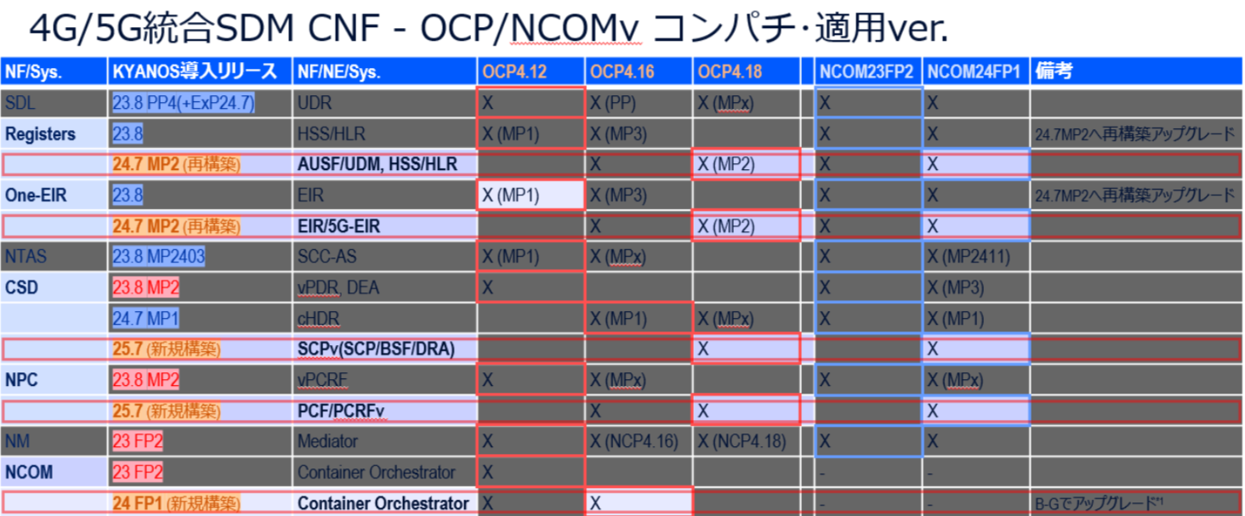
3. Compatibility Matrix
*OCP version is assumed to be OCP4.18
*OCP version compatible with NCOM24 FP1 is 4.13

Slide 15
Key Requirements, Use Cases & Solution
Key requirements, use cases for acceptance
Functional requirements and use cases : N/A
Non-functional Requirements –
Target Capacity : refer to next slide
Security, Operational, Automation : N/A
Alarm + Performance management : NZEv
GR / DR (Solution & Trigger) :
Geo Redundancy : SCP_BSF, NPCv *refer to “Solution overview”
Disaster recovery：NCOMv *refer to “Solution overview”
Migration : N/A (Lv623 scope)
Logical Solution Architecture diagram including system building blocks and key interfaces : refer to “Overview”
Topology diagram : refer to “Overview”
Number of sites : refer to “Solution overview”
Committed PreC3 features with timelines. : N/A
Reference to SharePoint folder : LINK
Change Management : LINK

Slide 16








7N 更新
Non-functional Requirements – Subscriber capacity requirement
618B
618A
【既存1080万加入収容上限】
Phase1拡張：～10月’25年
4G SDM仮想化
+5GC KYANOS移行
Phase2拡張：～12月’26年
既存HaaS
千代
大阪
多摩
小山
Phase3拡張：12月’26年～
千代
大阪
多摩
小山
KYANOS
UDR 23.0M (23.0M)
Out of scope
SDL21.2 ⇒21.8 ⇒22.8(VNF)
1600万収容
SDL22.8(CNF)
5400万+SA1800万収容 4500万+SA2300万収容
Ph.3(以降)で、SA6000万加入収容対応に向けたCNF増設の想定です。
⇒ SA6000万収容
AUSF/UDM21.8⇒23.8
1080万収容
AUSF/UDM 24.0M (xx.xxM)
AUSF/UDM24.7(CNF)
SA2400万収容
Ph.3(以降)で、SA6000万加入収容対応に向けてCNF増設の想定です。
HSS/HLR21.8(VNF) ⇒23.8(CNF)
1080万収容
⇒ SA60M subs
HSS/HLR23.8(CNF)
5400万+SA1200万収
HSS/HLR 12.0M (xx.xxM)
HSS/HLR24.7(CNF)
54M+SA12M subs
EIR同一クラスタ再構築による増設･アップグレードを実施。
One-EIR21.5(VNF)
One-EIR21.8(CNF)
1080万収容
One-EIR24.7(CNF)
54M+SA12M subs
4G/5G-EIR(コンボ)導入のため、再構築による増設･アップグレードを実施。
4G/5G-EIR 12.0M (60M)
SCPv/BSF/DRA 12.0M (xx.xxM)
5G-CSD25.7(CNF)
54M+SA12M subs ⇒ SA60M subs
SCPは途中増設が困難なため、初期構築時から最終収容想定容量で構築致します。
5G-CSD21.8(CNF) ⇒23.8
1080万収容
Out of scope
cHDRは途中増設が困難なため、初期構築時から最終収容想定容量で構築致します。
cHDR 12.0M (xx.xxM)
5G-CSD23.8(CNF)
5400万+SA1200万収容 ⇒ SA6000万収容
4G-CSD21.2(VNF)
5380万収容
NPC21.8(VNF)⇒23.8
1080万収容
PCFv/PCRFv 12.0M (xx.xxM)
NPC25.7(CNF)
54M＋SA12M subs ⇒ SA60M subs
PCFv/PCRFvは途中増設が困難なため、初期構築時から最終収容想定容量で構築致します。
5GSA契約Sub想定収容数
注1) ‘5400万’は、4G SDM収容想定加入者数 注2) ’SA1200万‘は、初期5GSA収容想定加入者数
(実トラフィックベースの収容数)

Slide 17
LV618 project organization chart
MS E2E
PGM
Ikawa
Lead PM/TPM Muto
E2E SA Hirano Bala (OCP)
E2E TM Inoue
IP design Team Yukumoto
WAR Odanaka
KDDI CDL Aoki
CI OCP Certificate Rajalakshmi
These nodes are managed by KDDI 認証Core department and VoLTE PGM Umeda-san manage those nodes.
CI
NCOM
PM Fukuhara
MS
HSS/HLR
PM Umeda
HSS/HLR
SA/TM
5G-EIR/EIR
PM Umeda
5G-EIR/EIR
SA/TM
AUSF/UDM
PM Yokota
AUSF/UDM
SA/TM
Hisashi Ota
(Inoue)
SCPv/Mirroring Server
PM Ariuna
SCPv SA/TM Kakuta
(Sakaguchi/Yong)
PCF/PCRFv
PM Natsume
PCF/PCRFv
SA/TM TBD
CI
SCD Local
SCD Central
MS
TDL
5G-EIR SA Ayan
Engineer Lead
Engineer team
TDL
AUSF/UDM SA Anadi
Engineer Lead
Engineer team
TDL
SCPv SA Vipin/yadav
Engineer Lead
Engineer team
Mirroring Server SA/TM Open
Engineer
Lead
Engineer team
TDL Yi-Chen
NCOM SA/TM Md Monirul Islam /Hashitani
Engineer Lead
Engineer team
TDL Rahul.12.Kumar (E2E)
TDL
HSS/HLR SA Anadi
Engineer Lead
Engineer team
TDL Sushil
SA/TM Rahul 26/Mayank Joshi
Engineer Lead
Engineer team
Notes:
あまり知られていない、パワーポイントで効率的に組織図を作る方法 [PowerPoint小技・小ネタテクニック]

Slide 18
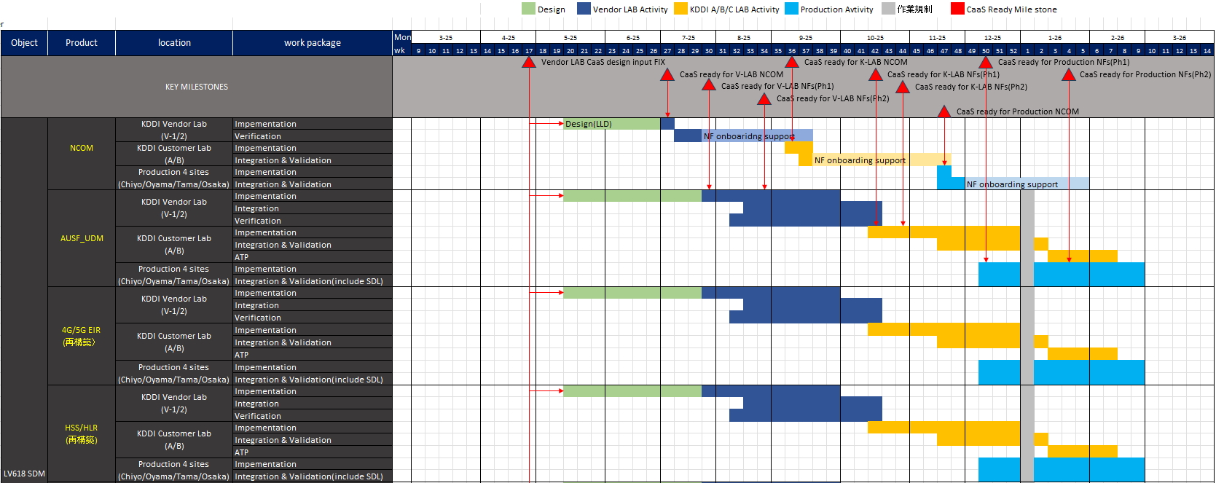
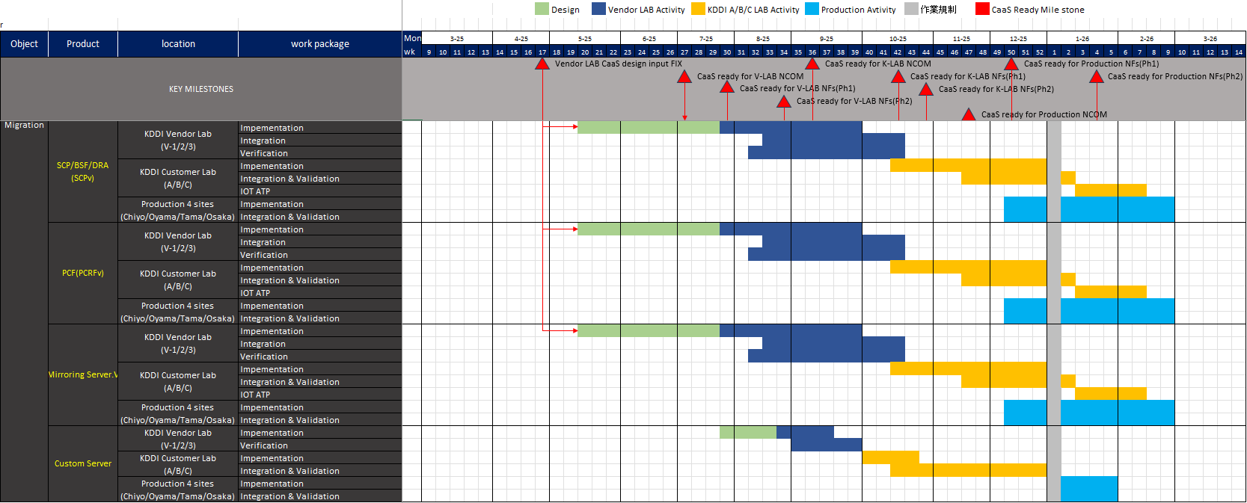
Project Plan & Critical Path
Now
LV618A
LV618A
LV618B
LV618B
LV618A
LV618A
LV618A

Slide 19
Acceptance Criteria
LV618A
■Acceptance 1: Assumed October 2025
Conditions: The work up to 10 in 2025 must be completed, and the deliverables of 1, 2, 3, 5, 7, 9, 10, and 12 on the previous page (initial version) must be presented.
■Acceptance 2: Assumed April 2026
Conditions: The work scheduled to be completed by April 2026 must be completed, and the deliverables of 13 and 24 on the previous page (initial version) must be presented.
■Acceptance 1: Assumed October 2025
Conditions: The work scheduled to be completed by 10 in 2025 must be completed, and the deliverables of 1, 2, 3, 5, 7, 9, 10, and 12 on the previous page (initial version) must be presented.
■Acceptance 2: Assumed April 2026
Conditions: The work scheduled to be completed by April 2026 must be completed, and the deliverables of 13 and 24 on the previous page (initial version) must be presented.
LV618B

Slide 20
Deliverables list
# | Document Name | Content and purpose | Language | Regional BWA
1 | HLD | - Basic design documents, Interface specifications, etc./- System Overview / Call Sequence Diagram | English | Yes
2 | LLD | - Detailed design documents, Parameter lists, etc. - System configuration files, etc. - System parameter management method - Equipment management - Lists of commercial settings corresponding to equipment ordered by buyer (Per equipment). | English | Yes
3 | Verification Test Plan | Including Verification Test Environment, Test scenarios and Test cases List, Schedule , Reporting | English | Yes
4 | IOT Test Plan | Same as the above | English | N/A
5 | Verification Test Report | Verification results. However, if the acceptance criteria for the software is met but there are remaining problems, provide the details of the problems, their impacts, workarounds and restrictions. | English | Yes
6 | IOT Test Report | Same as the above | English | N/A
7 | Software Release Note | Specify versions of soft wares, release dates, and the purpose(*) of release *Added features, fixed issues, and remaining issues | English | N/A
8 | Capacity Expansion Procedure | This procedure shall clearly state methods of sanity check of target devices, capacity expansion and methods for sanity check of target devices after the expansion. | English | N/A
9 | Alarm Manual | - Alarm list/- Alarm handling manual Actions for each alarm to be taken in operation when the alarm is generated to be specified. Manual for Troubleshooting. | English | N/A
10 | PM Counter Manual | Statistics list | English | N/A
11 | Instruction manuals | Instruction manuals for supplied equipments (Per equipment). | English | N/A
12 | O&M Manual | - Redundancy switching method/- Methods of sanity check of each equipment | English | N/A
13 | MOP | Procedures for Adding, Changing, and Deleting Settings | English | Yes
14 | Command Manual | - Command manuals/Documents showing examples of command usages and outputs. For procedures, both CLI and GUI procedures should be created. | English | N/A
15 | Software management | Software management method | English | N/A
16 | System Expansion Guidelines | Facility expansion work standard | English | N/A
17 | Document for pre-construction of commercial environment | Meeting materials for construction work commencement | English | N/A
18 | Verification environment management document | Documents related to Toyosu Lab environment construction(construction meeting document, construction completion document, list of settings) | English | N/A
19 | FOA Plan | (1) Test results of Nokia internal test (2) FOA Procedure (Should be confirmed in the vendor test environment in advance.) (3) FOA Schedule (It is expected to last about two weeks.) (4) FOA operation and communication system table (5) List of sanity check items during FOA period (6) FOA Acceptance Criteria Statement | English | N/A
20 | FOA Report | (1) Report of sanity check results during FOA period | English | N/A
21 | OJT material | ・Simplified version of operation manuals. ・Items to be included in OJT material will be discussed separately. ・List of Commercial Settings (Including setting values of system parameters that are independent from the service to be accommodated and the reasons.) | English | N/A
22 | Maintenance Agreement (Confirmation document) | (1) Maintenance operation flow (2) Maintenance SOW (3) Supplier Maintenance Operation Communication System | English | N/A
23 | Site test report | Verification results of acceptance tests conducted at commercial equipment construction. | English | N/A
24 | Commercial work completion report | This document will be submitted after CRO is completed. | English | Yes

Slide 21
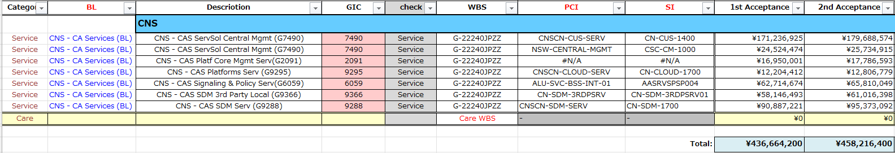

Cost Baseline
LV618A
LV618B
PTA Template V.2.0_2023 CNS GBC Japan

Slide 22
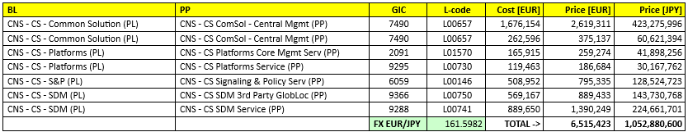
Cost Baseline
Revenue, Cost, Risk Cost, Target SM% per Product Line/GIC
Please see WtD G5 Link:
WtD-G5-BusinessCase
ServiceCost:
40_Service_Cost
OEM -> SM 30%
Services -> 36% SM
Global SM = 35.6%

Slide 23
Key Dependencies
List high priority dependencies on Customer, 3Ps, R&D, other BGs:
# | Dependency | Immediate Milestone Impacted | Need By Date | Team | Owner Name | On Critical Path? | Impact of Delay
1 | CaaS OCP cluster ready for each environment | Refer to slide 20 “Project Plan & Critical Path” |  | xGN | Takagishi | Yes | NCOM deploy delay at V lab
2 | NOKIA V-lab NCOM ready for NF installation |  |  | NOKIA | Fukuhara | Yes | NF deploy delay at V lab

Slide 24
Risk management
Since there are a wide range of departments related to infrastructure vendors, KDDI, xGN, and our company, we will promote PJ by closely sharing external and internal information.
Risk Items | Background and Description | Risk Avoidance Measures | When to Apply
Disk Performance Problems (Performance Test) | Disc performance-related measures have occurred in the JCOM PJ | Based on information sharing from PJs that have already been executed, measures are applied during construction and verification in this PJ (Consider when creating LLDs) | During lab construction and verification JCOM: #24175 VOLTE: QA#5430, QA#5462
Delay in lab construction | CNF on-board delay to KYANOS | Obtain information such as problem occurrence event and solution from the executed PJ (JCOM) and apply it to the construction work | During lab construction and commercial construction
Problem leakage due to lack of consideration of the test scope | Failure to prevent problem leakage due to insufficient test scope | After examining the necessary background call type and SO type, item review was conducted from the viewpoint of ensuring the completeness of the test scope | When developing the test plan At the time of verification
Leakage of KPI problem | 5 At GC Ph1, JCOM PJ, problem was leaked because KPI check was omitted. | In performance test and long-term stability test, check from the viewpoint of whether statistical information can be correctly measured by the equipment under evaluation and the EMS side. | When creating KPI verification items 5GC Ph1:#20099 JCOM PJ:#28306
The following measures should be taken together from the review of past cases.

Slide 25
Risk management
Risk Items | Background and Description | Risk Avoidance Measures | Time of application
Lack of consideration of commercial environment | Lack of consideration of call processing type that actually occurs in operation caused an assumed event when commercial work is performed | Background Examination of call type | During test planning
Misunderstanding of work schedule (method) | When the connection with OAM equipment is integrated with commercial equipment: An omission in consideration was discovered at the time of work approval. | Agreement on verification items before the procedure verification/rehearsal Commercial work procedure establishment completed before XX | ・At the time of procedure examination ・At the time of procedure examination
Unexpected event occurred in commercial work | When the connection with the OAM equipment is integrated with the commercial equipment: The commercial configuration and SW operating conditions were not considered at the time of procedure examination | At the time of procedure examination, the actual working time period was considered, and the conflict with the periodic processing was confirmed, and the validity of the work execution order was confirmed. | At the time of design implementation

Slide 26
Communication/Conference Management
Customer Meeting
.
Conference Information | Schedule | Implementation Time | Participant | Agenda Contents | Adjustment Method | Operation method
Regular project (KDDI Data Core Technology Department, xGN Administration Node) | Scheduled | Every Friday 11:00~12:00 | xGN/NOKIA | Progress, issues, and risk sharing | 〃 | 〃
[Existing] Middle Meeting | Held regularly | Every other Wednesday 17:30-18:30 | KDDI General Manager/xGN General Manager/NOKIA CDL/NOKIA | Sharing progress, issues, and risks at the middle level | 〃 | 〃
[Existing] General Manager's Meeting General Manager's Meeting | Regular meeting | Once a month (set each time) | General Manager, General Manager, KDDI Division/NOKIA CDM | High-level sharing of progress, issues, and risks | Coordinating the next meeting during the meeting | 〃
Internal Meeting
Conference Information | Schedule | Implementation Time | Participant | Agenda Contents | Adjustment Method | Operation method
Internal Project sync-up meeting (Overall) | Scheduled | (TBD) Every Tuesday 14:00~15:00 | NOKIA project key members | Progress, issues, and risk sharing | 〃 | 〃
Notes:
Regular overall
Schedule needs to be adjusted
xx:xx~xx:xx
KDDI/xGN/NOKIA
Overall progress, issues, and risk sharing
Regular
Conference call
Report and discussion based on data

Slide 27
Project Repository, Tools & Access
Project Repository:
PDR directory where all project documents will be stored and maintained : LINK
PMAT ID and link : MP1000065
including presales documents for Handover : Refer to PTA document
Project Tools:
Customer Tools & Access
Nokia Tools & Access
Nokiamine (Ticket tool) : LINK
Sales force (Ticket tool for Delivery/L3)
JIRA (Ticket tool for RnD)
Business planner tool (Resource request, Demand)
Project tool (Finance management)

Slide 28
Project Readiness Assessment (PRA) Actions & Status
Item # | Action | Category | Owner | Issue Date | Deadline | Closed Date | Status | Remarks
1 | PTA
2
Exec Summary
This opportunity (628) is 100% and PO expected early May. Scope: logical next step of integration and migration after CNF build and onboarding scope on KYANOS (618) whose execution has commenced. Migration strategy can be reused from other projects. Technically, solution is complex but familiar, and major risk is resourcing.
Key Points & Actions
1. TCO is only delivery (May to July ’27) . Care scope will be separate. No upgrade planned during project. No HW, SW – only services.
2. Solution is migration of SDL (VNF) to combined 4G and 5G SDL (CNF)
3. CNF versions will be 24.7 / 25.7.
4. Pre-C3s: 2 x Deal breakers – committed.
5. Total ~70M subs – 4G 45M 5G 24M; 55M subs will be migrated as part of other projects such as VOLTE. 623 will involve migration of 15M 5G subscribers
6. Migration – no separate tool will be used. As used in other projects, SDL Proxy Migration Feature will be used.
7. No security requirements. Perf testing will be performed by customer
8. Tests for acceptance – existing 4G/5G services.
9. Services :
a. Onsite and offsite resources used to cater for onsite JP speaking resources and MOPs in Japanese for KDDI to cater for this very complex program
b. Issue : Resource issue flagged for both market and domains which is heavily impacting 618 and now also a heavy risk for 623
c. Forecast resources required in the system - @Kunio Ikawa (Nokia) @Rahul 12. Kumar (Nokia) @Yi-Chen Chiu (Nokia) @Carlos Gonzalez de Requena Farr (Nokia)
10. Migration – 2M duration taken . strategy from existing projects to be reused
11. Standard TSD & SSD not used – review the ppt and feedback on key contractual clauses to be incorporated in the slide pack - @ThienMing Foo (Nokia)
Project Readiness Assessment (PRA) Actions has been completed.

Slide 29
Next 20-day plan and deliverables
Key Actions
# | Action | Owner | Date
1 | Internal project kickoff | Ikawa | 6/9
2 | HLD / v lab LLD design start | Each NF SA | Design fixed target : 7/25
3 | Project preparation (WBS, SvO, PJ tool, PMAT) | MS : Muto SSP : Rahul, Sushil CI : Yi-chen | TBU
Key Deliverables
# | Deliverable | Owner | Date
1 | HLD | Each NF SA | Design fixed target : 7/25
2 | V lab LLD | Each NF SA | Design fixed target : 7/25

Slide 31
Agenda
Project Context and Background – Customer & Nokia
Scope – HW, SW & Services – Nokia and any 3rd Party
Key Requirements, Use Cases and Solution
Project Organisation
Project Plan and Critical Path
Acceptance Process
Milestone Table – Milestones , Criteria, Payment & Revenue recognition
Share of Responsibility – Customer vs Nokia, Nokia Internal, Nokia vs Supplier
Cost Baseline
Key Document Deliverables
3rd Party Scope & Milestone
Logistics for HW Shipment
Key Dependencies
Key Risks
Stakeholders, Communication and Governance Plan – Customer, Internal and 3rd Party
Project Repository, Tools & Access
Project Readiness Assessment (PRA) Actions & Status
Next 20-day plan

Slide 32
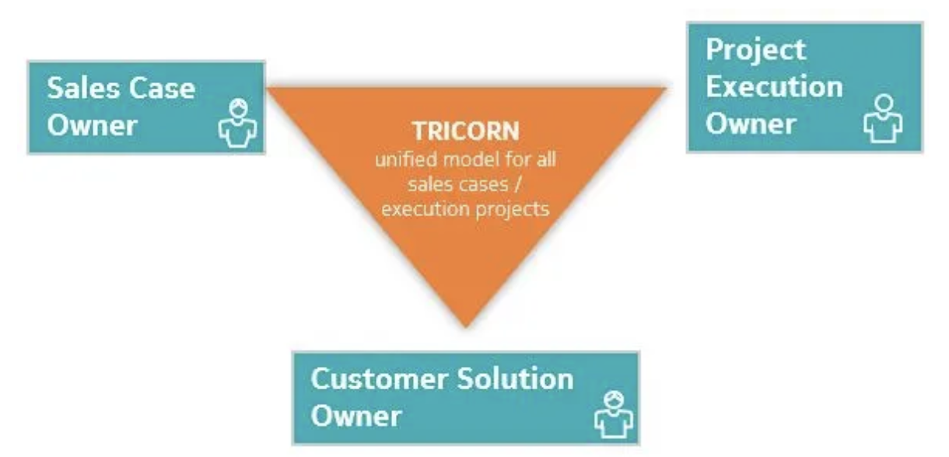
Audience – Kick Off | Organized by PEO (BGDM or Customer PM)
Account Manager
Sales Leader
Presales Solution and Services Managers
Product Line Manager
Business Group Delivery Manager
Project Director
Lead Architect
Project Contract Manager
Legal (optional - if applicable/required)
Market Operations and Procurement
Commercial/Pricing Manager
Project team members – PM, SA, TPM, TDL, DA, others involved to date
Customer Care Manager (optional - if applicable/required)
Domain Delivery Lead
Market PMO Manager
Project Financial Controller
Cost & Progress Manager
Customer PM MUST ensure that TRICORN roles are covered
Tricorn Model (sharepoint.com)

Slide 33
Key Risks
Top 5 prioritized risks with high probability and high impact ($$ and customer):
# | Category | Risk description | Impacted immediate milestone | Impact Quantum | Treatment – Mitigate / accept/transfer | Risk actions | Owner | Key Contri to mitigate
1
2
3
4
5
Kickoff資料参照
Risk Management
Every month, plan internal and customer risk management sessions to look at risks of immediate milestones and any major ones for the rest of the program
Risk register will be maintained
Do incorporate the risks identified in presales phase.

Slide 34
Stakeholders, Communication & Governance – Customer & Internal
Key Customer Stakeholders
Key Nokia Stakeholders
Name | Team | Role & Designation
Name | Team | Role & Designation
Customer Meeting & Governance
Comms Type | Stakeholders | Type | Artefact - Owner | Frequency /date | Owner
Weekly Project | Nokia & customer project team | meeting | Weekly Project Status Report -PM | e.g. weekly/ Wednesday | PM
Fortnightly Governance | Nokia: Customer | meeting | Governance Pack - PD | Every 2nd week - Friday | PD
Monthly Steering Co. | Nokia: Customer | meeting | Steering Co Pack - BGDM | Every month – 15th | AM
Internal Meeting & Governance
Comms Type | Stakeholders | Type | Artefact - Owner | Frequency /date | Owner
Weekly Project | Nokia project team | meeting | Internal weekly Project Status Report -PM | e.g. weekly/ Wednesday | PM
Internal Sales/Delivery Governance | PM, TDL, SA | meeting | Internal Governance Pack - PD | Every 2nd week - Friday | PD
Internal Delivery Governance | Nokia: Customer | meeting | Internal Steering Co Pack - BGDM | Every month – 15th | AM

Slide 35
SoR – Customer vs Nokia, Nokia Internal, Nokia vs Supplier
Customer & Nokia SOR
Nokia & 3P SOR
Activity | Customer | Nokia
Activity | R | S
Activity | Nokia | 3P
Activity | R | S
Internal Nokia SOR
Activity | CNS | MN | NI
Activity | R | S
Mention the critical , complex scenarios often with grey areas for which we’ll need clarity prior and present here : e.g.: HW delivery, site readiness, cloud install

